Slide 1

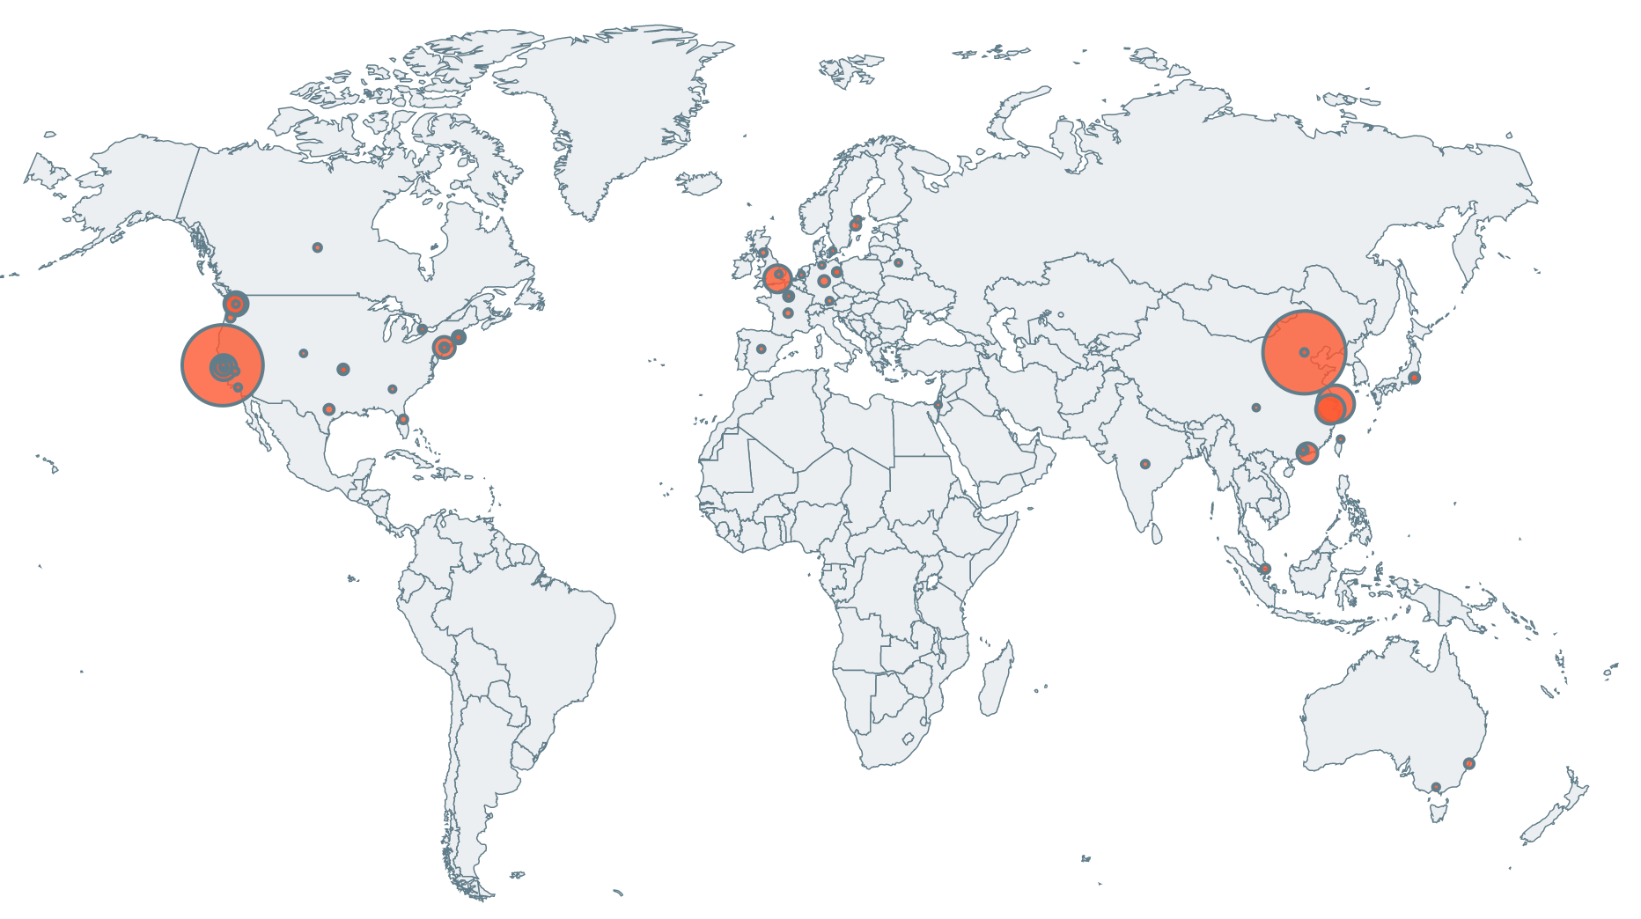
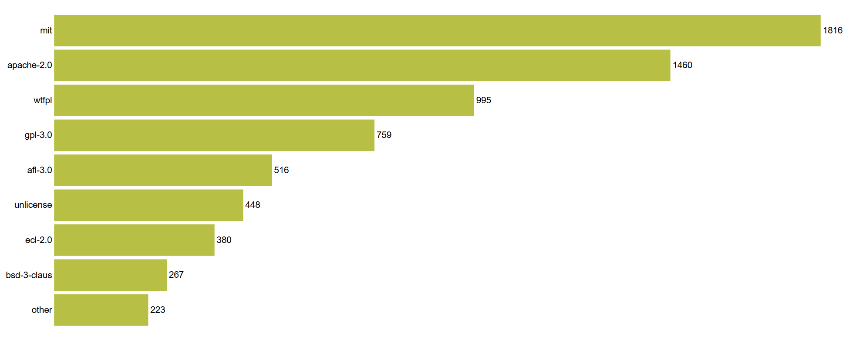

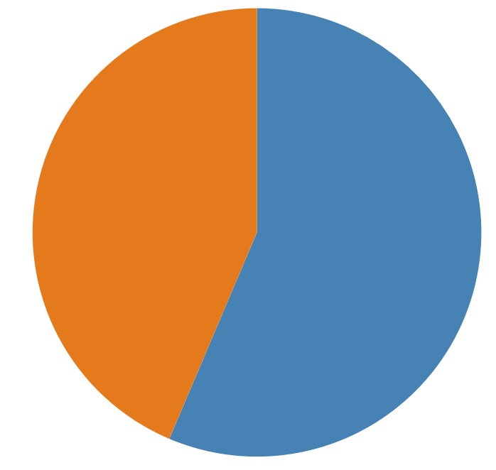
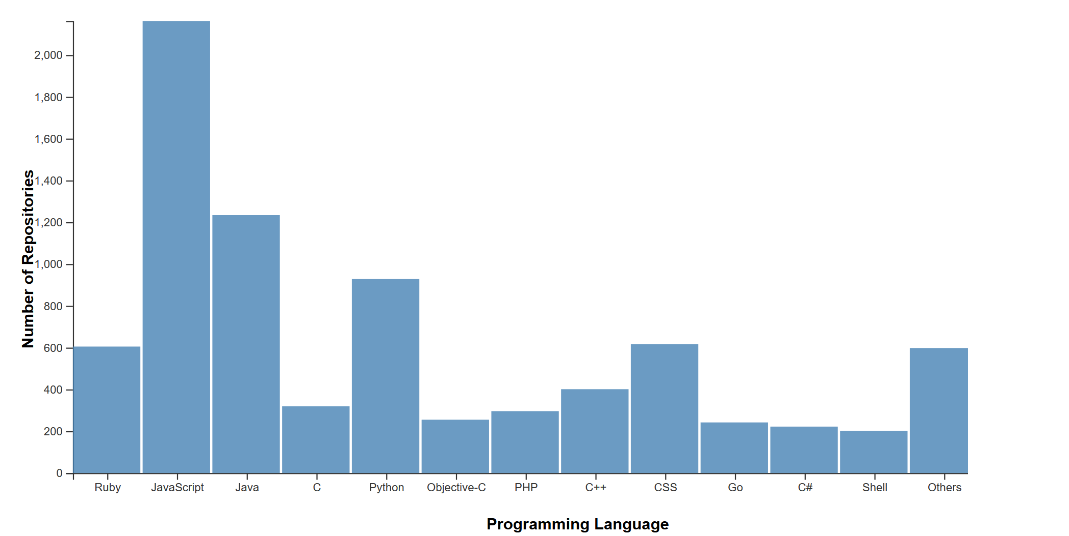
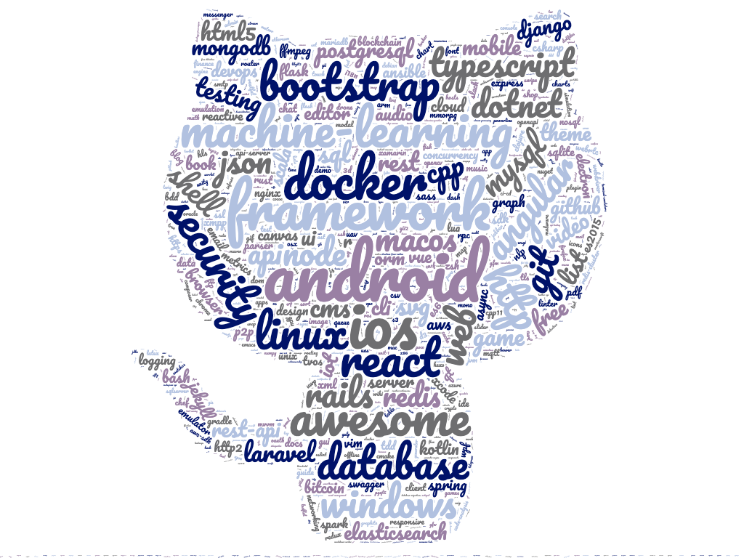
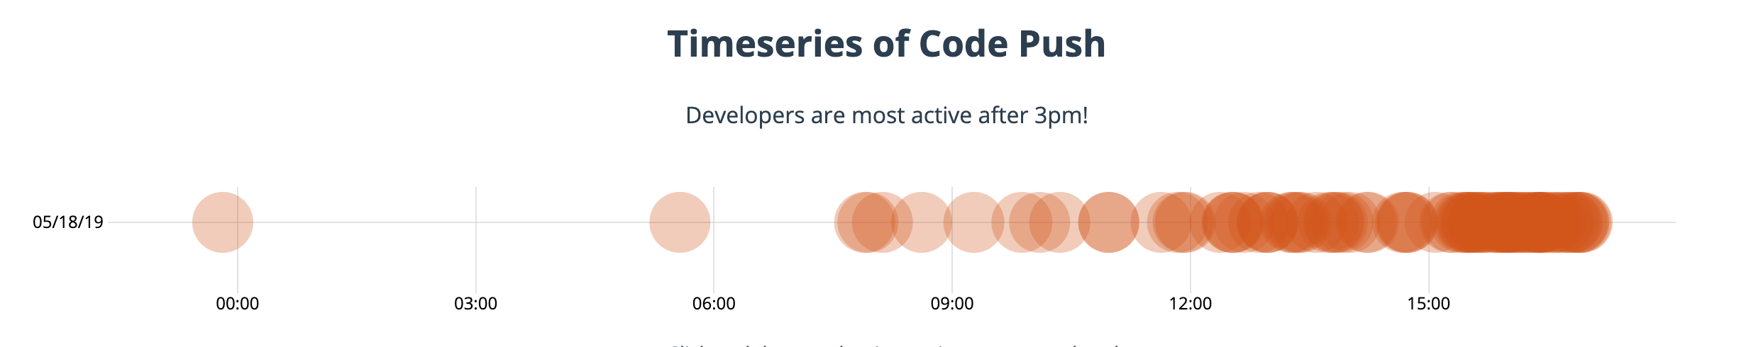
Visualization of top Open-Source projects on Github
CSE-564 Visualization
Mallikarjuna Rao Budida, Satish Muddana (G62)
Introduction
Where are the contributors based out of
Open Source License distribution
GitHub is a web-based hosting service for version control using Git. This is an attempt to visualize the attributes of leading open-source projects on Github.
The number of forks to a repository is taken as the deciding factor for popularity of an open-source project. Github being the de-facto destination for open-source contributions in software engineering, this visualization reflects the overall software industry trend as well.
mit stands tall among the open source licenses
Data Collection
Data was collected using a combination of Github APIs coupled with Google Geolocation API for location services.
Github Search API was requested with selective querying of fork_count. For each repository in the result, the owner information was crawled using a separate API. The location of the owner was obtained by doing an address to lat/long translation using the Google Geolocation API. The topics pertaining to a repository are part of Github’s experimental project to tag repositories.
Who owns the Repo?
Most Frequently used Programming Languages
Silicon Valley remains the top hub of open source project owners. Beijing is a close second.
56% of the top repositories are managed by organizations.
Trending Topics on Github
Inferences
JavaScript remains to be a top pick by programmers around the world, beating its next biggest competitor by about 100%
Learning Javascript is the easiest way for programmers to contribute to open-source projects. Silicon Valley is where most of the contributors are located at. Programming for Android, ios is the new trend. Organizations hold a major share of open source projects. It also looks like most of the work happens between 3pm and midnight.
What time of the day are programmers are most productive
These are the top trending topics active contributors on Github are working on. Android, IOS are the most active technologies, followed by Docker, Machine Learning at a distant third.
References
Data was collected from Github developer API https://developer.github.com/v3/.
Word clouds generated from https://www.wordclouds.com/
Bubble World map from https://www.react-simple-maps.io/bubbles-map

